Slide 1
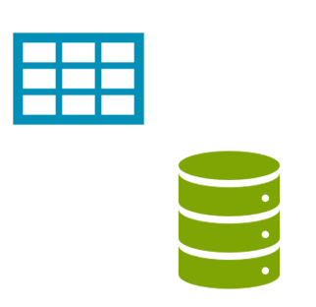
SQL
Session 1
Notes:
Hello Everyone. My name is ….... I will be your instructor for the SQL course. I hope everyone is healthy and ready for the session.
Alright, let’s start with PearDeck. Did you complete the pre-class activity?

Slide 2



Did you complete the pre-class activity?
Notes:
Hard or Easy
Use this template to do a quick temperature check and self-reflection about the homework. You can learn which students might have struggled with the assignment and therefore might need more attention today.
🍐 This is a Pear Deck Draggable™ Slide.
🍐 To edit the type of question, go back to the "Ask Students a Question" in the Pear Deck sidebar.

Slide 3
Table of Contents
What is a database?
What is in a database?
Structured Query Language (SQL)
SQL Language Elements
Notes:
This course will introduce the fundamentals of SQL (Structured Query Language).
By the end of this course, you will have learned and been familiar with fundamental SQL to interact with the databases.
you will learn how to:
Understand the basics of Relational Databases
• Retrieve data from single or multiple tables
• Process data with row and aggregate functions
• Manipulate data with subqueries
• Create and modify tables
Let’s get to know today’s session topics.
We’ll start with the definition of a database.
Then, you will learn the database concept and its usage in our daily activities.
Then we’ll explore what is inside the database.
Next, we’ll learn SQL (Structured Query Language) and its elements to communicate with the database.
******
Bu kurs, SQL'in (Yapılandırılmış Sorgu Dili) temellerini tanıtacaktır.
Bu kursun sonunda,
veritabanlarıyla etkileşime geçmek için temel SQL'i öğrenmiş olacaksınız.
İlişkisel Veritabanlarının temellerini
Tek veya birden çok tablodan veri almayı
Fonksiyonlar ile verileri işlemeyi
Alt sorgularla verileri işlemeyi
Tablolar oluşturumayı ve değişiklikler yapmayı
Öğrenmiş olacaksınız
Bugünün oturum konularını tanıyalım.
Bir veritabanının tanımıyla başlayacağız.
Ardından, veritabanı kavramını ve günlük faaliyetlerimizde kullanımını öğreneceksiniz.
Sonra veritabanının içinde ne olduğunu keşfedeceğiz
.Ardından, veritabanıyla iletişim kurmak için SQL'i (Structured Query Language) giriş yapacağız.

Slide 4
“The beginning of wisdom is the definition of terms.”
Socrates (470 – 399 B.C.)
Notes:
What I try to say here, if we can define the terms in a correct way, it’s easier for us to understand the the subjects we are working on.
We tried to define the database, database management systems, SQL and relational database and database operations.

Slide 5
What is a database?
1

Slide 6

Could you define
what the database is?
Notes:
Summarize
Have students write a quick, 1-2 sentence summary of the information they’ve just learned.
🍐 This is a Pear Deck Text Slide
🍐 To edit the type of question, go back to the "Ask Students a Question" in the Pear Deck sidebar.

Slide 7
What is a database?
“A database is an organized collection of data stored
in a computer system.”
Notes:
database concept is a general name given to systems where data is stored in a certain order.
Database is a regular collection of structured information or data that is usually stored electronically in a computer system.
Extra
Data is the raw material that can be processed for any computing machine.
For example − Employee name, Product name, Name of the student, Marks of the student, Mobile number, Image etc.
Information is the data that has been converted into more useful or intelligent form.
For example: Report card sheet.
Knowledge
The human mind purposefully organizes the information and evaluates it to produce knowledge.
Example of data, information and knowledge
A student secures 450 marks. Here 450 is data, marks of the student is the information and hard work required to get the marks is knowledge.
***
veritabanı kavramı, verilerin belirli bir sıra ile saklandığı sistemlere verilen genel isimdir.
Veritabanı, genellikle bir bilgisayar sisteminde elektronik olarak depolanan düzenli bir yapılandırılmış bilgi veya veri koleksiyonudur.
Data is a collection of facts, such as numbers, words, measurements, observations or just descriptions of things. Data can be qualitative or quantitative.
A database is a collection of information that is organized so that it can be easily accessed, managed and updated.
EkstraVeri, herhangi bir bilgi işlem makinesi için işlenebilen ham maddedir.
Örneğin - Çalışan adı, Ürün adı, Öğrencinin adı, Öğrencinin Markaları, Cep telefonu numarası, Resim vb.
Bilgi, daha kullanışlı veya akıllı bir forma dönüştürülmüş veridir.Örneğin: Rapor kartı sayfası.
Bilgiİnsan zihni bilgiyi bilinçli olarak organize eder ve bilgi üretmek için değerlendirir.
Veri, bilgi ve bilgi örneğiBir öğrenci 450 puan alır. Burada 450 veri, öğrencinin notu bilgi ve notu almak için gereken çalışma bilgidir.

Slide 8
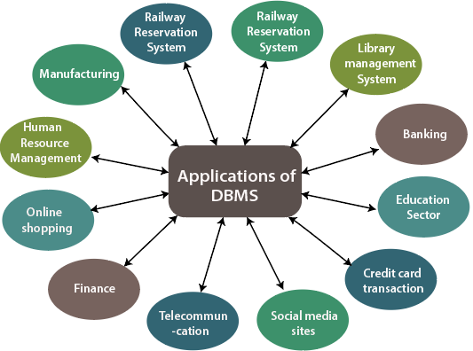
How are databases used in the real-world?
Notes:
Today, private or public institutions all keep the information they contain in their database.
If the population directorates, transportation centers, banks, schools and universities can access the requested information within seconds from among the registered people, it is thanks to the database systems.
World is full of data.
People use data and databases with or without awareness in their daily life activities.
our bank, your grocery store, an app on your cell phone, websites all use databases to keep track of your data.
When you access a website, the website starts to collect your data (e.g. accessing date and time, your location, your browser info) and store it in its database.
Let's take another example.
When you order a product on a commercial website, your order is stored in a database.
You withdrew money from your bank account.
Your bank stores this transaction in the database.
Social media platforms such as Facebook, Instagram,
Twitter use databases to store data like members, their friends, member activities, messages, advertisements, etc.
Category Usage
Banking&Finance Customer information, accounts, transactions
Education Student information, course registrations, grades
Telecommunication Internet&phone usage, subscriber information
Human resources Employees, managers, salaries, hire&termination dates
Websites Products, visitors, website traffic statistics
Transportation Passenger, reservation and schedule information
Think about other applications of databases. Try to give some examples.

Slide 9
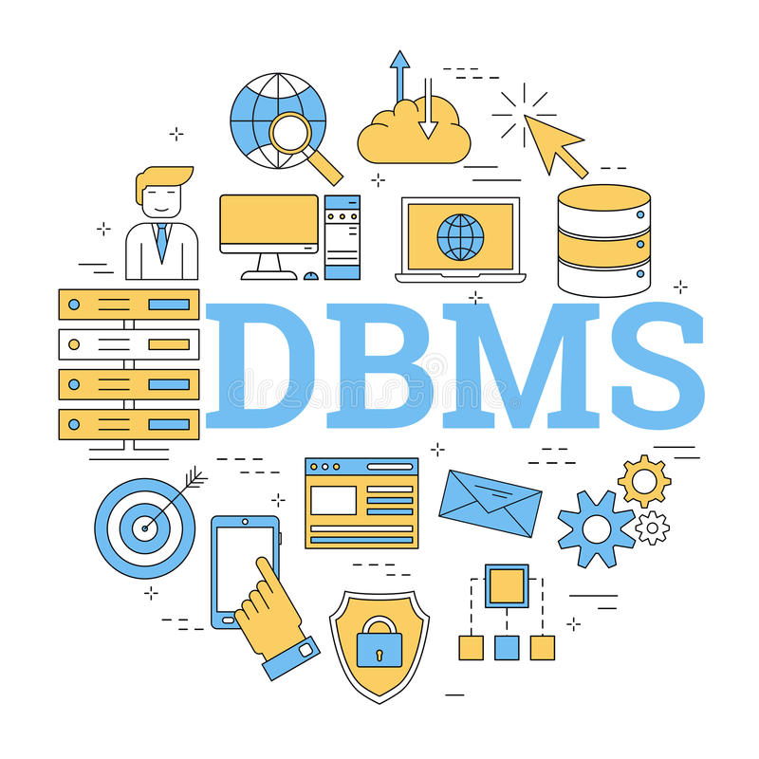
Database Management System
Notes:
What is a DBMS?
A database is typically controlled by a database management system (DBMS).
Data and DBMS along with the applications that are associated with them are called a database system, often shortened to just database.
A database typically requires a comprehensive database software program known as a database management system (DBMS).
A DBMS serves as an interface between the database and its end users or programs, allowing users to retrieve, update, and manage how the information is organized and optimized.
There are different database management systems on the market according to companies’ need. You can see the most popular ones on the slide.
VTYS nedir?
Bir veritabanı tipik olarak bir veritabanı yönetim sistemi (DBMS) tarafından kontrol edilir.
Veriler ve DBMS, bunlarla ilişkili uygulamalarla birlikte bir veritabanı sistemi olarak adlandırılır ve genellikle yalnızca veritabanı olarak kısaltılır.
Bir veritabanı tipik olarak veritabanı yönetim sistemi (DBMS) olarak bilinen kapsamlı bir veritabanı yazılım programı gerektirir.
Bir DBMS, veritabanı ile son kullanıcılar veya programlar arasında bir arabirim görevi görerek kullanıcıların bilgileri düzenlemesine ve optimize etmesine, almasına, güncellemesine ve yönetmesine olanak tanır.
Piyasada firmaların ihtiyacına göre farklı veri tabanı yönetim sistemleri bulunmaktadır.
En popüler olanları slaytta görebilirsiniz.

Slide 10
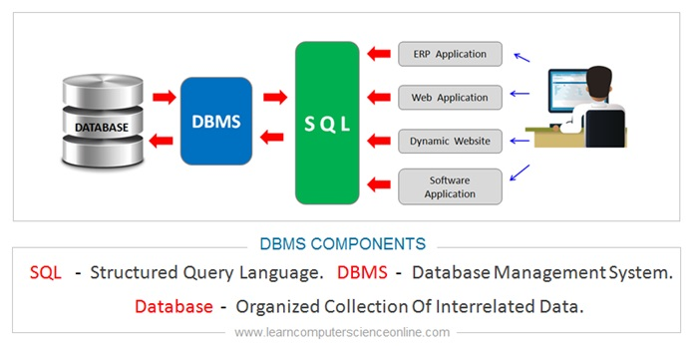
Database Management System
Database Management System
Language
Applications
Database
User

Slide 11
Structured Query Language (SQL)
3

Slide 12
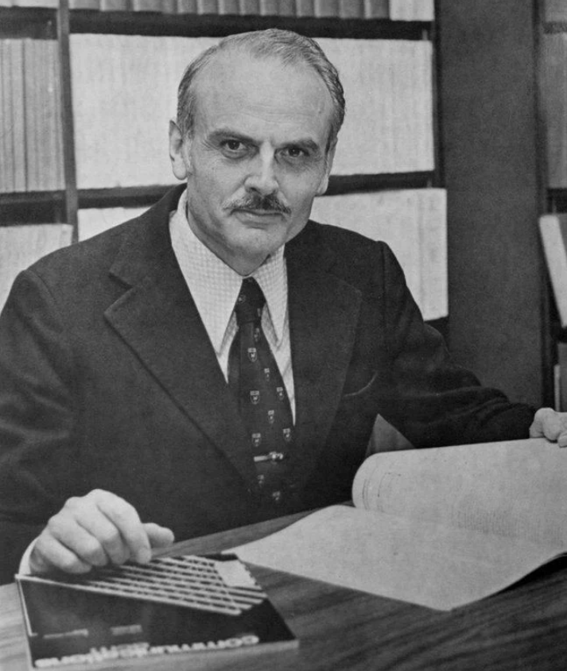
Types of Database Management System
Edgar Frank "Ted" Codd
(19 August 1923 – 18 April 2003)
English computer scientist
While working for IBM, invented the relational model for database management.
Notes:
Actually, the term "relational database" was invented by E. F. Codd at IBM in 1970. Codd introduced the term in his research paper "A Relational Model of Data for Large Shared Data Banks".
In this paper and later papers, he defined what he meant by "relational".
One well-known definition of what constitutes a relational database system is composed of Codd's 12 rules.
However, no commercial implementations of the relational model conform to all of Codd's rules, so the term has gradually come to describe a broader class of database systems.

Slide 13
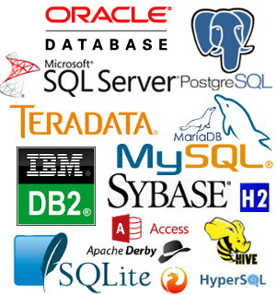
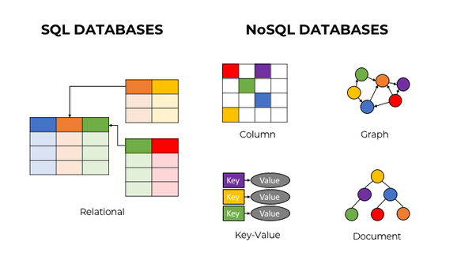
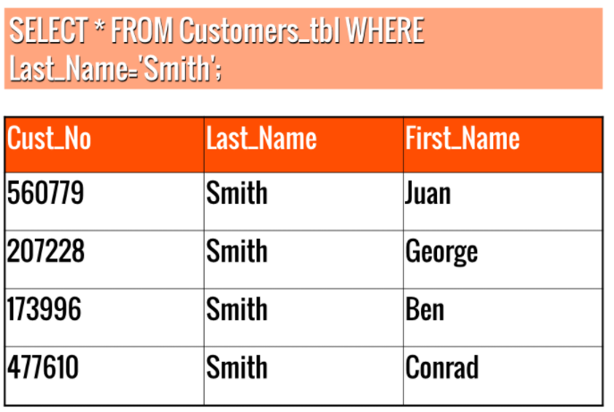
Types of Database Management System
Relational Database – SQL
Non-Relational Database – NoSQL
Relational Database
Notes:
SQL (stands for Structured Query Language) is accepted as the standard Relational Database Management System (RDBMS) language.
So we usually prefer to call Relational Database as SQL and Non-Relational database as NoSQL. (Not Only SQL)
A relational database is a type of database that stores and provides access to data points that are related to one another.
Relational databases are based on the relational model, an intuitive, straightforward way of representing data in tables.
The columns of the table hold attributes of the data, and each record usually has a value for each attribute, making it easy to establish the relationships among data points.
SQL (Yapılandırılmış Sorgu Dili anlamına gelir), standart İlişkisel Veritabanı Yönetim Sistemi (RDBMS) dili olarak kabul edilir.
Bu yüzden genellikle İlişkisel Veritabanını SQL olarak ve İlişkisel Olmayan veritabanını NoSQL olarak adlandırmayı tercih ederiz.
(Not Only SQL)İlişkisel veritabanı, birbiriyle ilişkili veri noktalarını depolayan ve bunlara erişim sağlayan bir veritabanı türüdür.
İlişkisel veritabanları, verileri tablolarda temsil etmenin sezgisel ve basit bir yolu olan ilişkisel modele dayalıdır.
Tablonun sütunları, verilerin özniteliklerini tutar ve her kaydın genellikle her öznitelik için bir değeri vardır, bu da veri noktaları arasında ilişkilerin kurulmasını kolaylaştırır.

Slide 14
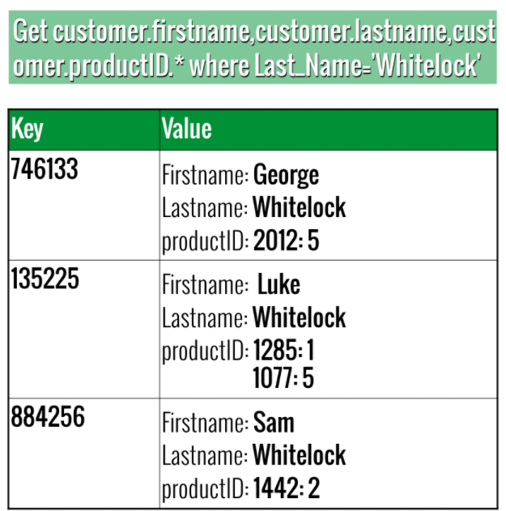
Types of Database Management System
Notes:
SQL (stands for Structured Query Language) is accepted as the standard Relational Database Management System (RDBMS) language. So we usually prefer to call Relational Database as SQL and Non-Relational database as NoSQL.
Left-> an example for SQL database and a query
Right-> an example for the NoSql Not Only SQL

Slide 15
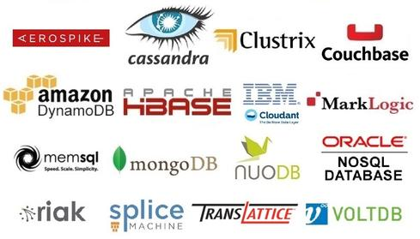
Types of Database Management System
Relational Database
Non-Relational Database
Notes:
A database is typically controlled by a database management system (DBMS). Data and Typically, there are two main database storage types:
A relational database is a type of database that stores and provides access to data points that are related to one another. Relational databases are based on the relational model, an intuitive, straightforward way of representing data in tables. The columns of the table hold attributes of the data, and each record usually has a value for each attribute, making it easy to establish the relationships among data points.

Slide 16
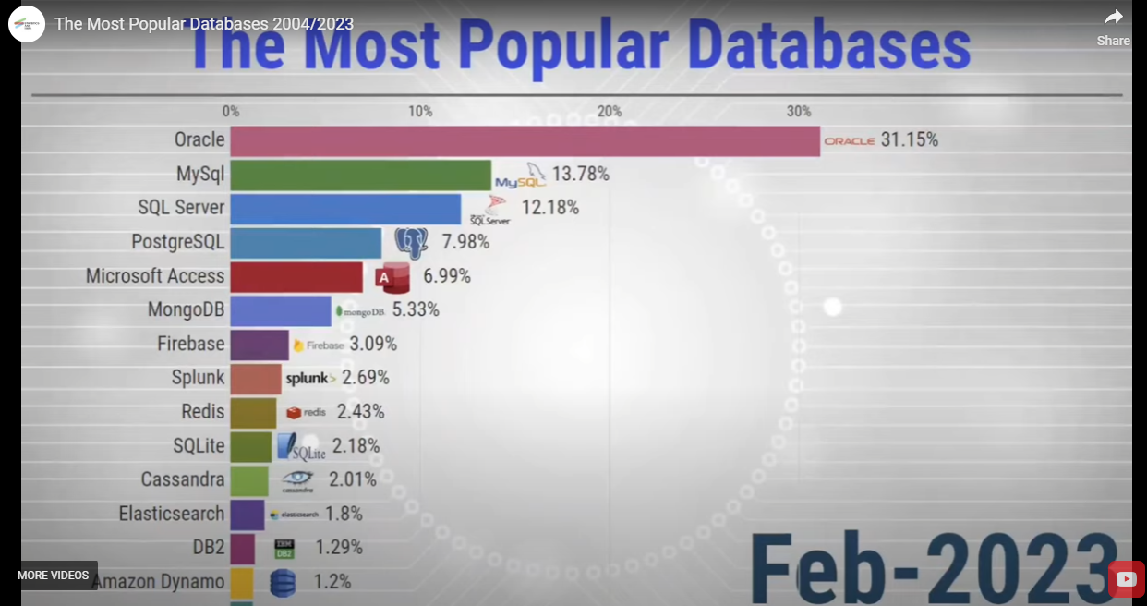
Which DBMS?
Notes:
https://statisticsanddata.org/data/the-most-popular-databases-2006-2023/

Slide 17
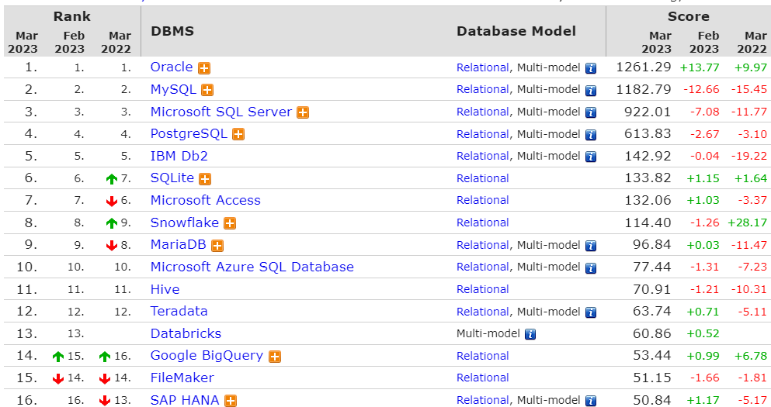
Which DBMS?
Notes:
https://db-engines.com/en/ranking/relational+dbms

Slide 18

Which DBMS will we use in the lesson?
“SQLite is a C-language library that implements a small, fast, self-contained, serverless, high-reliability, full-featured, SQL database engine. SQLite is the most used database engine in the world. SQLite is built into all mobile phones and most computers and comes bundled inside countless other applications that people use every day.”
Notes:
We will use SQLite as a relational database management system during on LMS during the pre-class.
Whenever an SQL statement is present in the course, a SQL playground (on which you can run your SQL queries) is already embedded at the end of the lesson.
You can try your queries on the SQL playground.
We also kindly request you to install DB Browser for SQLite to run the queries on your local machine. The installation process is very straightforward and easy. The setup file is just 16 MB.

Slide 19
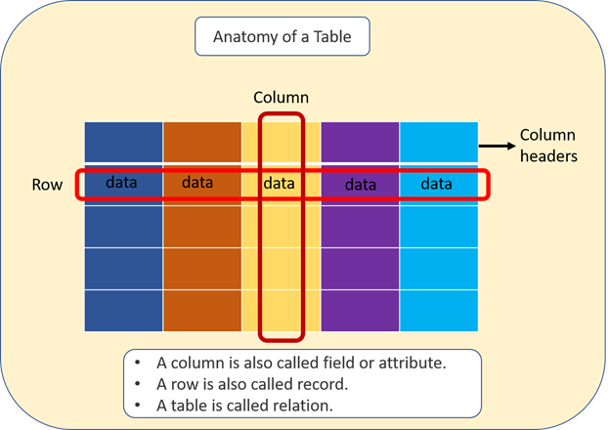
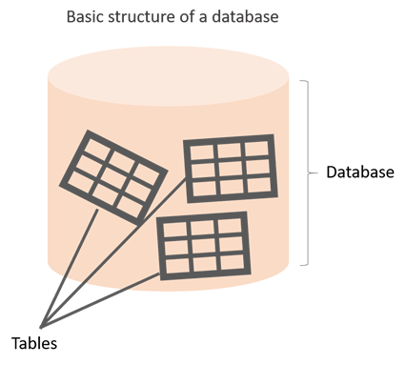
What is in a database?
Notes:
The information inside the database is grouped into tables.
A table in a database is called a database table.
Tables are the basic unit of data storage in databases.
We used the term structured data. Structured data here means table. A table consists of columns and rows. You may think of it as an Excel or Google spreadsheet. Although there are similarities between the database table and Excel/Google spreadsheet, they are different things. We won't get into details here. A table is made up of columns and rows. A column is a piece of data stored by the table. A row is a single set of columns that describe the attributes of a single thing. Columns should have a unique name. Columns and rows together make up a table.

Slide 20
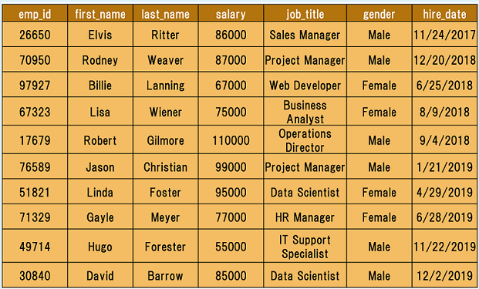
What is in a database?
employee table
Notes:
this is an example;
Let's take the case of a company database. Suppose that it has two tables. One is employees, and other is departments. Let’s take a closer look at the employees table. Here is the breakdown of the table.
Table's name is employees.
The table has seven columns (aka, fields or attributes)
The table has ten rows (aka, records or tuples)
Table's column header names are: emp_id, first_name, last_name, salary, job_title, gender, hire_date
Inside the employees' table, there is data about each employee in the company
Of course, a real-world company would have many more employees. We use a small table to illustrate concepts.
recap;
Q: What is a table, column and row?
A: A table is an organized collection of data (relational) stored in the form of columns and rows. Columns can be categorized as vertical and rows as horizontal. The columns in a table are called fields (attribute) while the rows can be referred to as records.

Slide 21
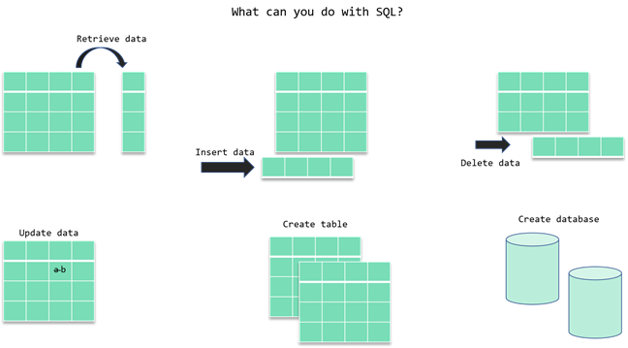
Structured Query Language (SQL)
CRUD
Notes:
SQL stands for Structured Query Language and used to communicate with relational databases.
SQL is a declarative language, not a procedural language.
You write a single SQL declaration and hand it to the DBMS. The DBMS then executes internal code, which is hidden from us.
CRUD operations:
Create Read Update and Delete
Most commercial database systems employ the SQL language.
With SQL, you can access or manipulate data stored in the database. T
here are different types of access.
These are:
• Retrieval of data from the database
• Insertion of new data into the database
• Updating the data in the database
• Deletion of data from the database
No need to talk about below for now.
But Boyce and Chamberlin teamed up to create a standard way of requesting information from these newfangled “relational databases.” They called it “Structured English Query Language” or “SEQUEL,” for short. It later got even shorter and became “Structure Query Language” or “SQL.”

Slide 22
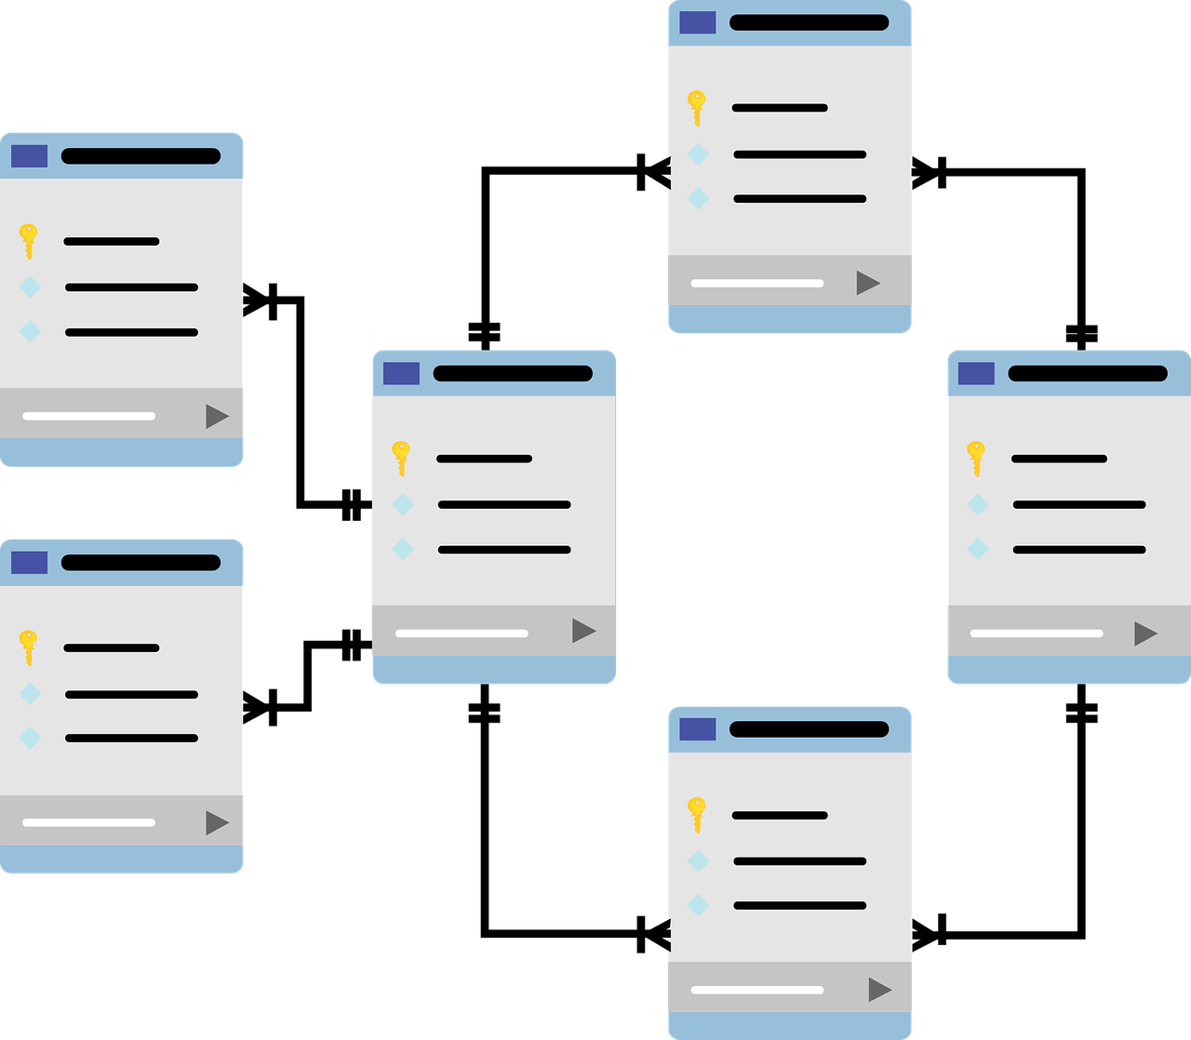
What is in a database?
Notes:
Now, it's time to communicate with our database with SQL.
Please remember, the purpose of this course is not to model or design a database, that’s something totally different and you first need to understand the basics.
The focus of this course is to teach you Structured Query Language, which will enable you to communicate with databases, at a basic level and a little at an intermediate level. When you continue to your paths, you will be using different databases. And SQL will be the language you will use when going through communication with them..

Slide 23
SQL Language Elements
4
Notes:
SQL
SQL (stands for Structured Query Language) is accepted as the standard Relational Database Management System (RDBMS) language. So we usually prefer to call Relational Database as SQL and Non-Relational database as NoSQL.
Until now in the course, what we've shown you some relational database features (structured data, tables, rows, columns, etc). Of course, there are more than those features coming in the upcoming parts of the course. During the pre-class phase of the SQL course, we will use SQLite as an RDBMS tool.

Slide 24
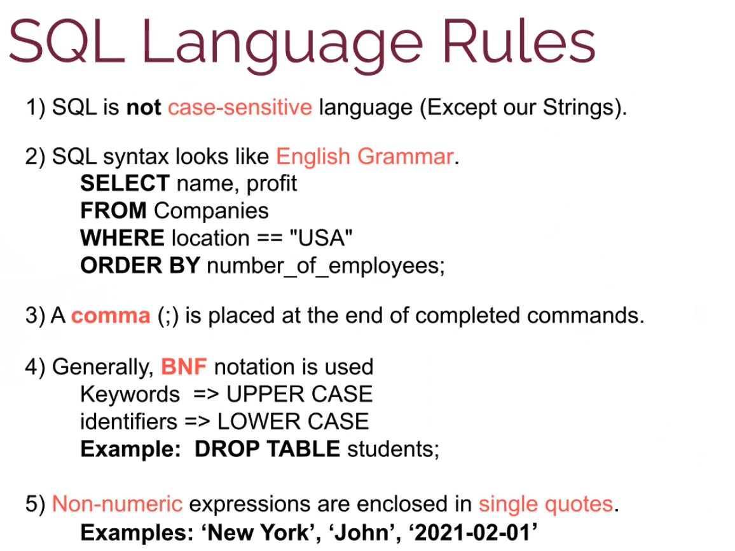
Notes:
What is BNF notation explain it with examples?
In computer science, Backus–Naur form (/ˌbækəs ˈnaʊər/) or Backus normal form (BNF) is a metasyntax notation for context-free grammars, often used to describe the syntax of languages used in computing, such as computer programming languages, document formats, instruction sets and communication protocols.

Slide 25
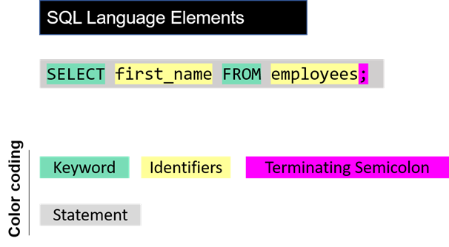
SQL Language Elements
(SQL Syntax)
Notes:
The whole command SELECT first_name FROM employees; is called statement. Let's breakdown of this statement. Herein SELECT, FROM words are keywords. They are special commands for SQL. first_name, employees are identifiers. SQL statements end with a semicolon (;). SQL Language Elements is also called SQL Syntax.
There are other SQL elements which we will cover later in the course. In the next part, we will introduce you SELECT statement in detail. We will learn the syntax and start to write our commands.

Slide 26
Introduction
You can retrieve rows from the columns of the table
by using SELECT statement.
SELECT statement is used with FROM keyword.
The SELECT statement is used to select data from a database.

Slide 27
SQL
Selecting column /columns/ all columns
SELECT column_name FROM table_name;
column_name(s)
*
Notes:
Basic Syntax
SQL statements start with a keyword like SELECT, INSERT, UPDATE, DELETE, etc. and all the statements end with a semicolon (;).
Semicolon at the end indicates that the statement is completed and ready to be executed.
SQL is also case insensitive, which means you can use both SELECT and select in your query. They mean the same thing for SQL.
Writing SQL commands in the upper-case is the most common and preferred style. But, you can write the same query in both ways.
White spaces and empty lines are ignored in SQL.

Slide 28
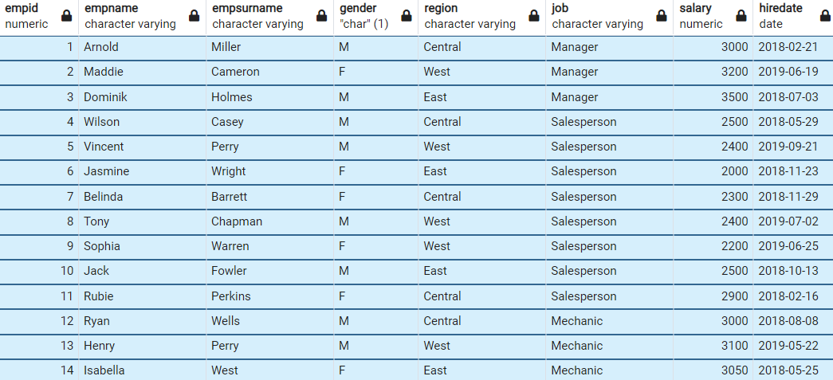
SQL
Notes:
!!! if column name include upper case you use table name between " "

Slide 29
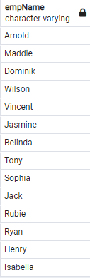
SQL
SELECT empname
FROM employees;

Slide 30
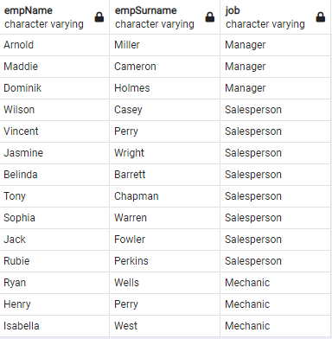
SQL
SELECT empname, empsurname, job
FROM employees;

Slide 31
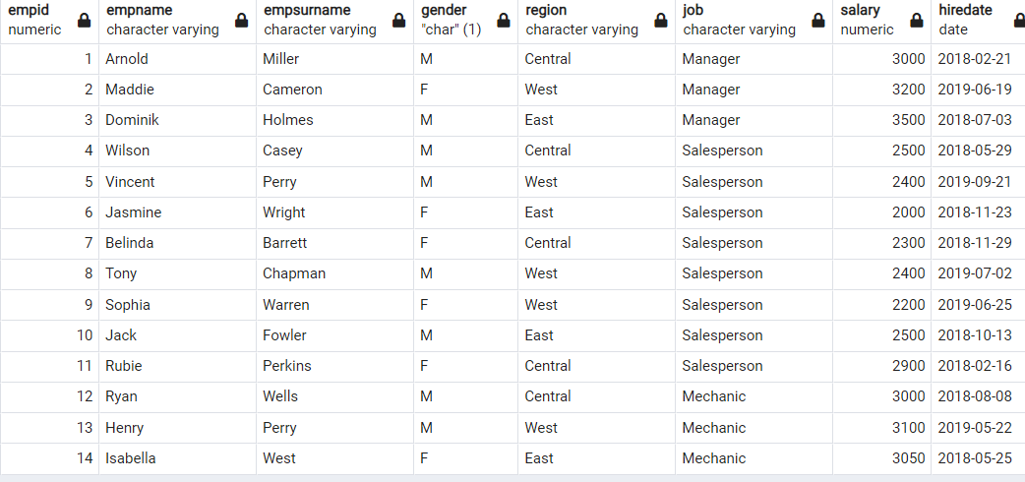
SQL
To retrieve all of the information from your table, an asterisk (*) character can be used after the SELECT
SELECT * FROM employees;

Slide 32



Drag your dot to how you are feeling:
Keep going, I understand
I’m a little confused
Stop, I need help!
Notes:
Temperature Check
WIth this slide, you can get a quick idea of how your students are feeling about the pace of the lesson. Getting consensus before moving on helps ensure everyone is still with you, and identify the students who might need extra attention.
🍐 This is a Pear Deck Draggable™ Slide.
🍐 To edit the type of question, go back to the "Ask Students a Question" in the Pear Deck sidebar.

Slide 33

THANKS!
Any questions?

